Slide 1
NEWLY DISCOVERED FACTS ABOUT GLEN REST CEMETERY
PRESENTATION AT MONTHLY MEETING
KERR COUNTY HISTORICAL COMMISSION
UNION CHURCH, KERRVILLE, TEXAS
BY WEIR LABATT
November 20, 2017

Slide 2
“We must never, ever forget who the people in the cemeteries were.
What did they do?
Where did they come from?
What did they leave behind?
We owe it to them to find out everything we can.
Without their sacrifice, who knows what the world would be like?”
Arthur Brookes, former associate, Cambridge American Cemetery and Memorial Cambridge, Great Britain

Slide 3
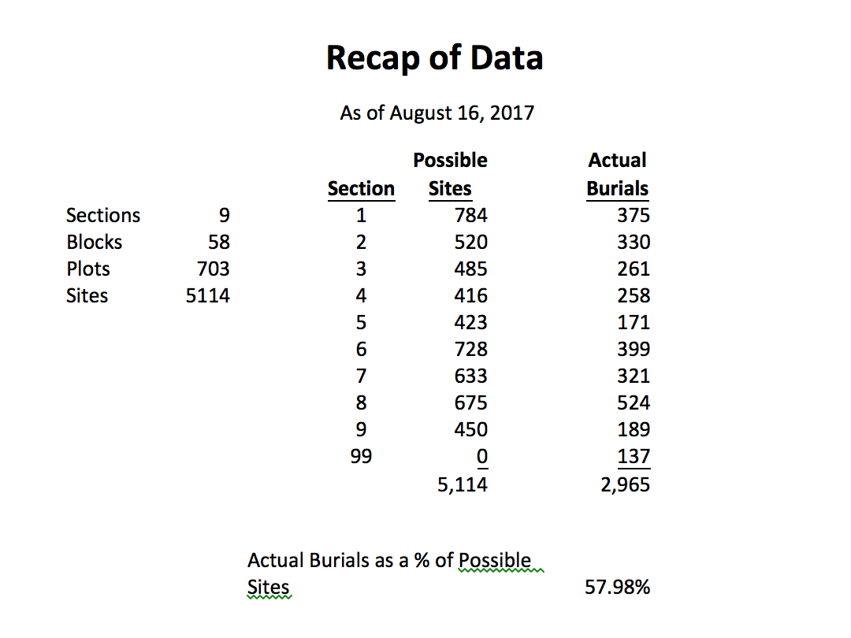

Slide 4
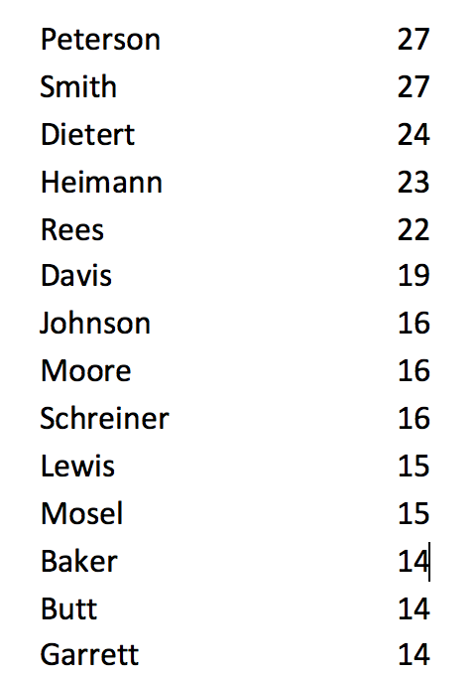
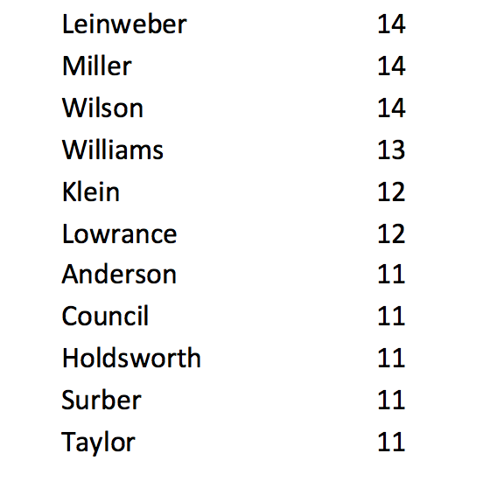
MOST NUMEROUS NAMES FOUND IN GLEN REST CEMETERY

Slide 5
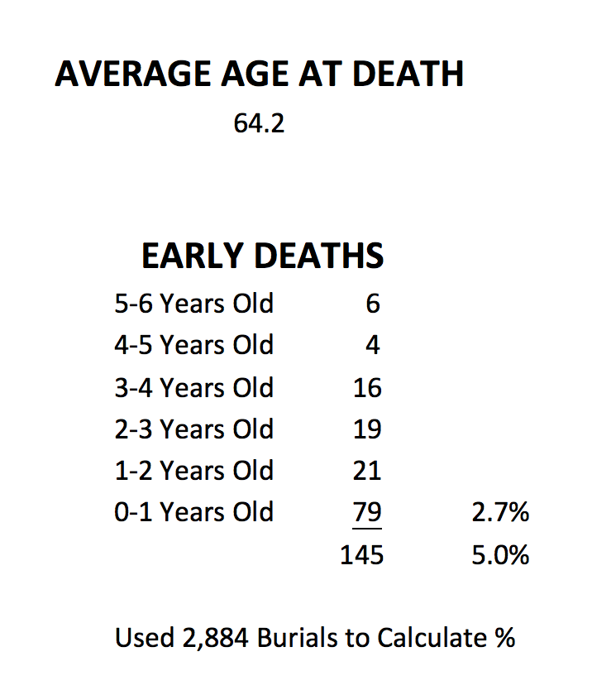

Slide 6
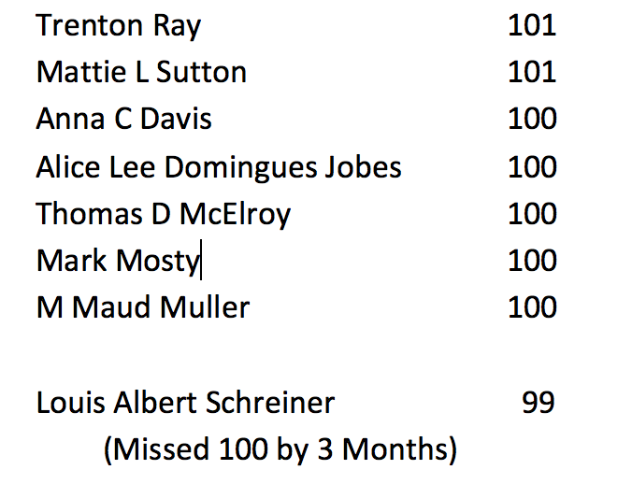
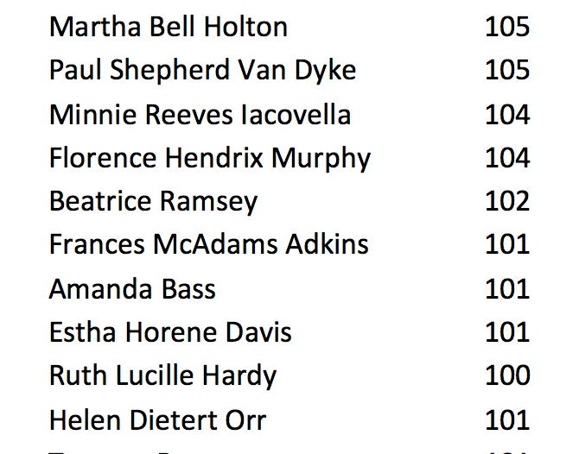
LIVED TO 100 YEARS OF AGE (17)

Slide 7
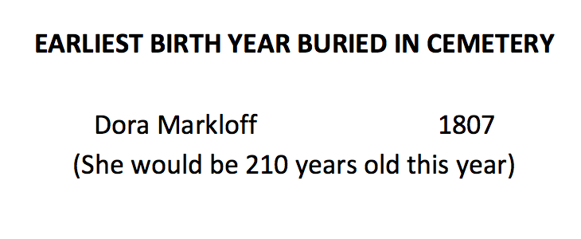

Slide 8
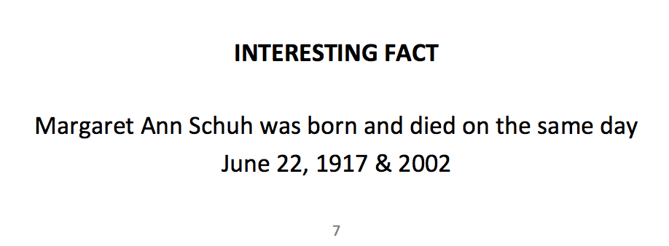

Slide 9
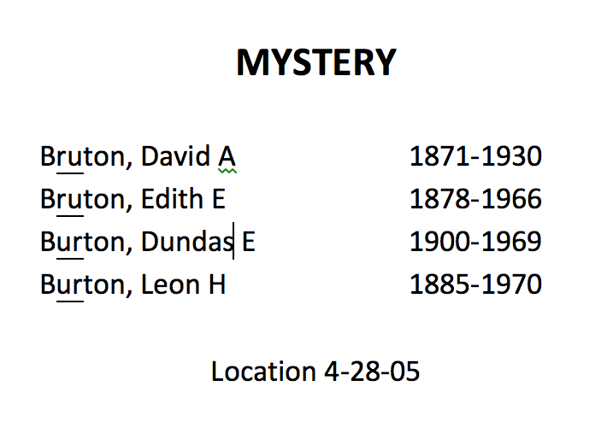

Slide 12
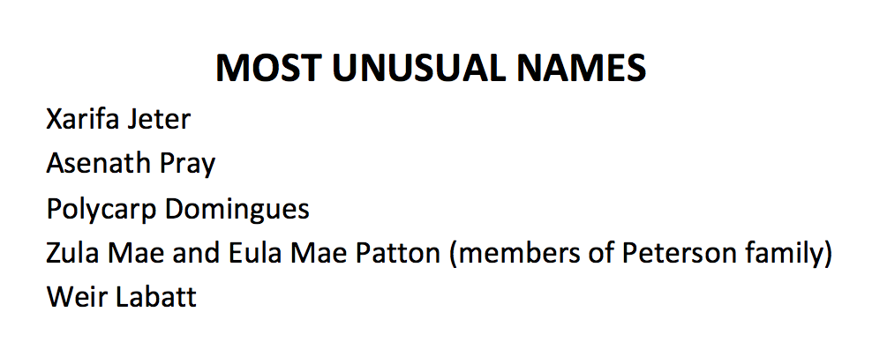

Slide 13
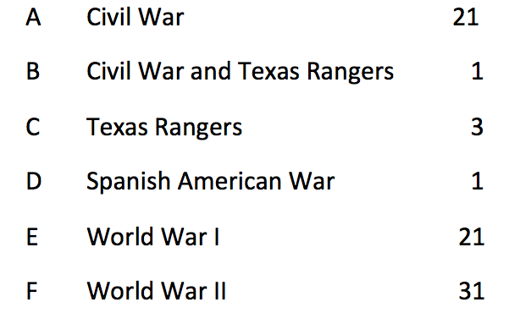
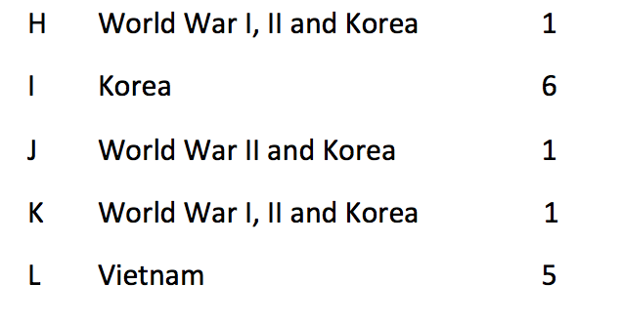
NEW PROJECT
Column O in Glenrestcemetery.com with codes that indicate Military Service (includes Texas Rangers)

Slide 14
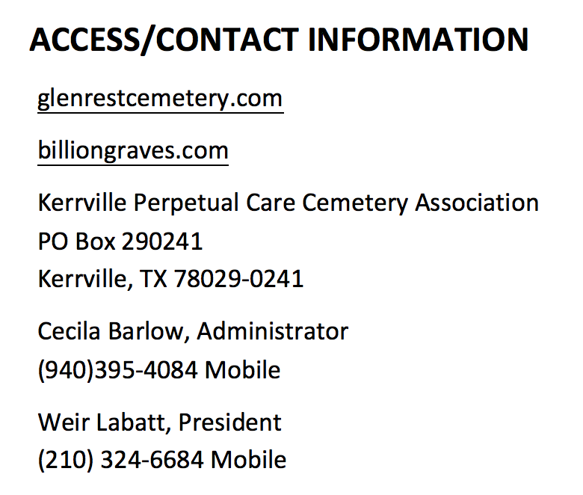

Slide 15
“Here lies nothing but a shell for her spirit survives in all of us”
Alice Tatum Hansen on her Headstone 8-54-05
“They are not dead
who live in lives
they leave behind.
In those whom
They have blessed,
They have a life again.”
From: No Ordinary Time p. 2750
Eleanor and Franklin Delano Roosevelt

